Slide 1
How to Publish in a Top Journal and Handle Writer’s Block?
David M. Boje, Ph.D.
Regents Professor, New Mexico State University
Slides & books to download at http://davidboje.com/Italy
Vita at http://davidboje.com/vita

Slide 2
Antenarrative
Antenarrative learning is important to organization. “In the absence of [antenarrative] learning, companies—and individuals—simply repeat old practices. Change remains cosmetic, and improvements are tighter fortuitous or short-lived: (Garvin, 1993: 2, bracketed addition, ours).

Slide 3
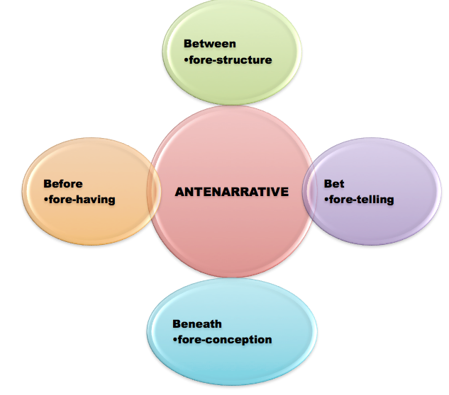

Slide 4
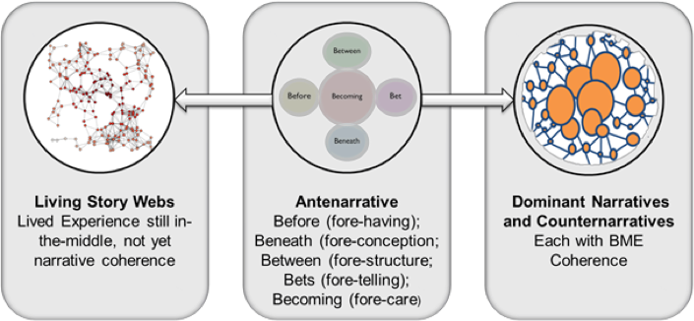

Slide 5
Today I write
Six main approaches to learning organization theory and praxis are considered. Senge’s Fifth Discipline, Nonaka, knowledge management, the Total Quality Management movement (TQM), Garvin’s scientistic approach, Argyris and Schon’s double loop learning, and various renditions of socio-technical-systems

Slide 6
First problematize
There is a problem in each of the six learning organization approach. After all is said and done, each one, is ‘business-as-usual’ despite the flexible project coupes, the learning was contextualized in a socioeconomic hegemony that privilege profiteering. As Cressey, Boud, and Docherty (2006: 22) put its “If all it does is address organizational problems, however, and does not nurture the group, it is probably inefficiently sustainability.”

Slide 7
Then Critique
What these six approaches to learning organization fail to consider is the how people’s working lives are dominated by the reining economic paradigm (neoliberalism profiteering) and how managerial mechanisms of control prevent learning organization aspirants form moving out of Post-Fordist, market forces, that have morphed in the current wave of Liquid Modernity.

Slide 8
And again
The hegemonic discursive practices of neoliberalism, its self-serving ‘progress narrative ’that rationalizes profiteering, in ways that oppress groups of people, prevent a learning organization from emerging that could feasibly address the planetary boundaries being exceeded in 6th Extinction

Slide 9
Make Antenarrative Bet
Antenarrative processes that are counter-hegemonic, have the potential to create new ways of noticing the 6th Extinction, the planetary boundaries, and to develop a learning organization rather that can rein in current waves of globalization rooted in profiteering that is harmful to people and planet. In the 6th Extinction the planet will survive, but with so few species, the survival of humanity is doubtful.

Slide 10
And step 2
The second step is to develop apparatuses such as counter accounts, hidden costs, and qualimetric that can be the basis of a new learning organization praxis (defined as theory plus methodology in action) that can possible address planetary boundaries being transgressed by current wave of globalization (i.e. Post-Fordism morphed into Liquid Modernity).

Slide 11
The Essence of Scholarly Impact | BizEd Magazine bized.aacsb.edu
WHAT IS THE MEANING of scholarly impact? How can researchers know when they’ve achieved it, and how can their schools best reward it? These nuanced questions are the subject of a project from the Academy of Management (AOM)
Top 5 indications include publication in top-tier journals, citations by other researchers, use as the basis of a scholarly book, ability to attract competitive grants, and publication in practitioner-focused outlets.
BUT majority of respondents find that journal lists, journal rankings, & impact factors “definitely” or “probably” do not reflect journal quality or scholarly impact, BUT measures are still used widely by academic institutions to evaluate faculty contributions. TIME FOR A CHANGE

Slide 12
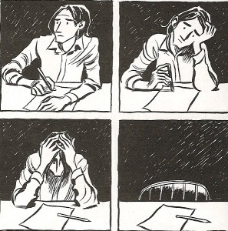
Writer’s Block
Most editor’s ‘HOW TO PUBLISH’ events give everyone writer’s block
The editor gets in-your-head and blocks everything creative

Slide 13
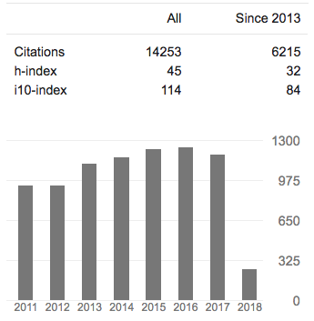
University wants Impact Factors, and it gives me writer’s block to focus on SHORT TERM H-Index & i10-Index
h-index, author-level metric, measures both productivity & citation impact of publications of scientist or scholar. Index based on scientist's most cited papers & the number of citations that they have received in other publications
i10 index refers to the number of paper with 10 or more citations

Slide 14
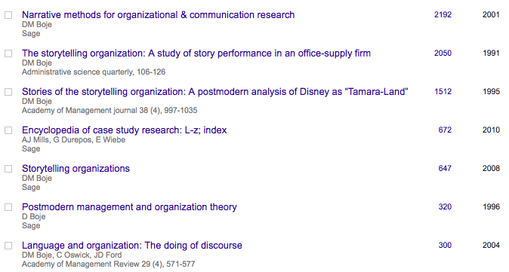
You are your Numeric? – give me writers block

Slide 15
Story of Academy of Management Publication
In my field, one of the top-ranked is ACADEMY OF MANAGEMENT JOURNAL took about 7 years to get published
Story of the Disney as Tamara-Land article
Presented it and a a consulting editor saw it, and I sent it, but they gave it to their doctoral class instead of submitting it & I waited
Two years to do 3 R&R’s with first editor who chose knowledgeable reviewers, then accepted, BUT
Another 18 monts when →New Editor said ‘Wait I have never accepted a qualitative article in my career’ so it must be reviewed again and pass: 4 R&R’s, PLUS another extensive R&R 75 item edit for language he did not know

Slide 16
How to overcome writer’s block?
I need a spacetimemattering of CREATING
Find a place to meditate and write EVERYDAY (or find change of scenery)
Write about what comes to mind
Have your special time to meditate and then write in the middle – jump to the middle and the beginning will come
Mattering with Good tools
Get in touch with your muse
Note-booking before computer-writing

Slide 17
1. Give yourself permission to write first, edit later 2. Have place & time to write each day 3. Write FAST as much as you can in 5 minutes 4. Turn idea into a living story
What to do about Writer’s Block
Our need to be perfect blocks our CREATIVE STORY-FLOW

Slide 18
You are your Citation Impact on Jan 17 2018 – give me writers block
Boje, D. M. (2001). Narrative methods for organizational & communication research. Sage. Cited by 2191
Boje, D. M. (1991). The storytelling organization: A study of story performance in an office-supply firm. Administrative science quarterly, 106-126. Cited by 2050
Boje, D. M. (1995). Stories of the storytelling organization: A postmodern analysis of Disney as “Tamara-Land”. Academy of Management journal, 38(4), 997-1035. Cited by 1513

Slide 19
The move to annual publication outcome measurement is ridiculous
It takes a decade to build reputation and acceptance of a theory in mainstream top tier journals
ADVICE: Build momentum in the newer journals that handle the creative and fresh concepts, so other scholars pick up on it and give it a mention in a top tier journal
STORY: It took 12 years to get Antenarrative into top tier journals such as ORGANIZATIONAL RESEARCH METHODS, HUMAN RELATIONS, & JOURNAL OF INTERNATIONAL BUSINESS
Notes:
Rosile, G. A.; Boje, D. M.; Carlon, D.; Downs, A.; Saylors, R. (2013). Storytelling Diamond: An Antenarrative Integration of the Six Facets of Storytelling in Organization Research Design.Organizational Research Methods (ORM) Journal, Volume 16 Issue 4
The microstoria of Burger King’s storytelling in space, time and strategic context
David M Boje, Usha CV Haley, and Rohny Saylors
Human Relations
Haley, U. C.; Boje, D. M. (2014). Storytelling the Internationalization of the Multinational Enterprise. Accepted on May 4th, 2014 at Journal of International Business Studies (JIBS)

Slide 20
Our Academy’s QUALITIATIVE IMPACTS of your Research on PRACTICE
Please provide examples/details of changes in business performance/practices arising from your research
I did a sting on smoke shops selling SPICE, fake weed, to get City Council to change the law
I worked with homeless veterans to introduce a drug policity, to stop the sale at the point of sale, the Smoke Shop selling SPICE, K-2, Bath Salts laced with who knows what designer chemicals.

Slide 21
IMPACTS of your Research on SOCIETY
Please provide examples/details of the influence of your research on local/regional communities and/or the wider society.
Jeanne Flora, David Boje, Grace Ann Rosile, Kenneth Hacker. (2016). Journal of Veterans Studies. Vol 1, No 1 http://veteransstudies.org/journal/index.php?journal=jvs&page=issue&op=view&path%5B%5D=1
Boje, D. M.; Hillon, Yue. 2017. "The Dialectical Development of “Storytelling” Learning Organizations: A Case Study of a Public Research University” its death spiral: can we reverse it?

Slide 22
Advice
Don’t let the university & academy Outcomes Asessment define your path
Write for the Long-term
Do something that Matters to You
Make a difference in the World with your writing
Always have a Plan B when you submit to Top Tier
Work on the Writers Block that Rejection Brings
Take Time to Celebrate each Small Win

Slide 23
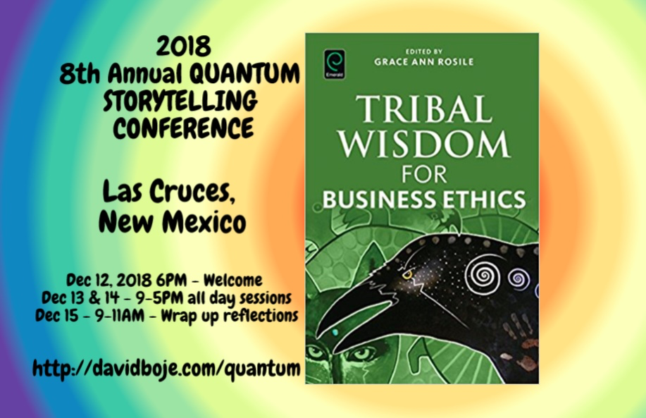
Q & A
Slides & books to download at http://davidboje.com/Italy

